Slide 1
Presentation 02
“Modeling Environment”
Sep xx, 2022

Slide 2
Structure: expectations
Has cost of built
Probability of working decreases over time
Based on probability of working, it may work or not at each step

Slide 3
Structure: example
Probability = 1 - (coeff * (dt_years ** degree))

Slide 4
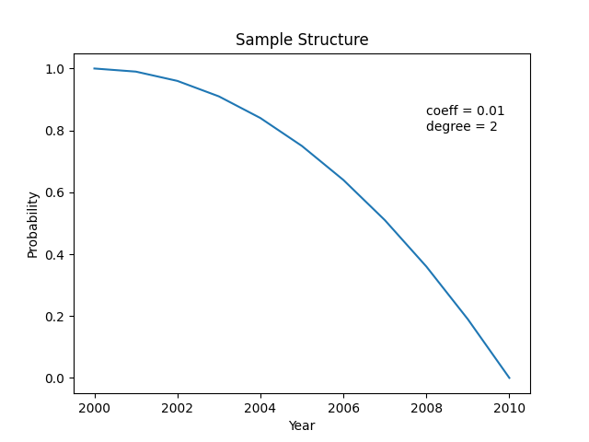
Structure: example
Probability = 1 - (coeff * (dt_years ** degree))

Slide 5
Structure: example

Slide 6
Infrastructure
Is a type of Structure
They have start and end points, and connect cities and people
Can handle certain recourses

Slide 7
Thank you for your patience

